Slide 1
Introduction To LINQ
An Overview Of Language Integrated Query

Slide 2
Overview
Why LINQ?
What problems will LINQ solve?
LINQ Query Expressions
A summary of major LINQ technologies
LINQ To Objects
LINQ To XML
LINQ To SQL
LINQ To Entities

Slide 3
Some C# History
Integrating data queries into C# has been a goal for years.
“LINQ” on the whiteboard
sequence<Employee> scotts =
employees.where(Name == "Scott");
“LINQ” in C# 2.0
IEnumerable<Employee> scotts =
EnumerableExtensions.Where(employees,
delegate(Employee e)
{
return e.Name == "Scott";
});

Slide 4
The Data Impedance Mismatch
Typical data access challenges
Different data types
Different data sources
Relationships versus hierarchies
Limited Intellisense or language support for data access

Slide 5
Manipulating Data
The data source generally determines the API and tools to use
Object Data
Generics
Algorithms
Relational Data
ADO.NET
SQL
XML Data
XmlDocument
XPath / XSLT

Slide 6
Enter LINQ
LINQ provides general-purpose query facilities
Object Data
Relational Data
XML Data
Language Integrated Query
(LINQ)

Slide 7
Standard Query Operators
Defined in the System.Linq namespace
Work on any IEnumerable<T>
CLS compliant (generics required)
string[] instructors = { "Aaron", "Fritz", “Scott", “Keith" };
IEnumerable<string> query = from s in instructors
where s.Length == 5
orderby s descending
select s;
foreach (string name in query)
{
Console.WriteLine(name);
}

Slide 8
LINQ Query Expressions
The same standard query operators work everywhere
Objects
Relational data
XML data
Over 50 operators defined
Filtering
Projection
Joining
Partitioning
Ordering
Aggregating
Similar to SQL
Select, From, Where, OrderBy, GroupBy

Slide 9
Language Integration
Languages and tools are aware of query expressions
Rich metadata
Static type checking
Intellisense
string[] instructors = { "Aaron", "Fritz", "Keith", "Scott" };
// error assigning IEnumerable<int> to IEnumerable<string>
IEnumerable<string> query =
from n in instructors
where n.Length == 5
orderby n descending
select n.Length; // creating IEnumerable<int>

Slide 10
LINQ’s Extensibility
Operator extensibility
We can implement our own operators
We can override standard operators for our own types
Provider extensibility
A LINQ Provider is a gateway to query-able types
PLINQ
LINQ to Flickr
LINQ to LDAP
LINQ to Amazon

Slide 11
LINQ to Objects
Replace foreach loops and other iterative code with LINQ expressions
IEnumerable<Process> processList =
from p in Process.GetProcesses()
where String.Equals(p.ProcessName, "svchost")
orderby p.WorkingSet64 descending
select p;

Slide 12
Deferred Execution
Query expression does not execute until we access the result
Treat query expressions as data
Build composable queries
Define Query
IEnumerable<Process> processList =
from p in Process.GetProcesses()
where String.Equals(p.ProcessName, "svchost")
orderby p.WorkingSet64 descending
select p;
foreach (Process p in processList)
{
Console.WriteLine("{0,10} ({1,4}) : {2,15:N0}",
p.ProcessName, p.Id, p.WorkingSet64);
}
Execute Query

Slide 13
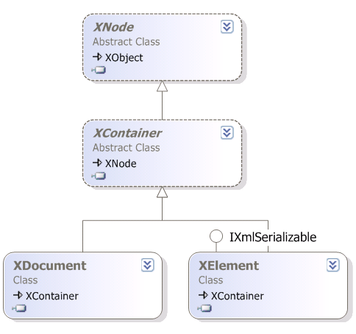
LINQ to XML
Not just another XML API
XElement is the core class in the System.Xml.Linq namespace

Slide 14
Functional Construction with XElement
Concise, readable XML creation
XElement instructors =
new XElement("instructors",
new XElement("instructor", "Aaron"),
new XElement("instructor", "Fritz"),
new XElement("instructor", "Keith"),
new XElement("instructor", "Scott")
);
<instructors>
<instructor>Aaron</instructor>
<instructor>Fritz</instructor>
<instructor>Keith</instructor>
<instructor>Scott</instructor>
</instructors>
instructors.toString();

Slide 15
Queries with LINQ to XML
Same standard query operators
XML specific extensions applied
XElement instructors =
new XElement("instructors",
new XElement("instructor", "Aaron"),
new XElement("instructor", "Fritz"),
new XElement("instructor", "Keith"),
new XElement("instructor", "Scott")
);
int numberOfScotts =
(from i in instructors.Elements("instructor")
where i.Value == "Scott"
select i).Count();

Slide 16
LINQ to SQL
LINQ to SQL and Entity Framework
Works with SQL Server 2000 / 2005 / 2008
Translates query expression into T-SQL
IEnumerable<Customer> customers =
from c in context.Customers
where c.Country == "France"
orderby c.CustomerID ascending
select c;
SELECT [t0].[CustomerID], [t0].[CompanyName], [t0].[ContactName],
[t0].[ContactTitle], [t0].[Address], [t0].[City],
[t0].[Region], [t0].[PostalCode], [t0].[Country],
[t0].[Phone], [t0].[Fax]
FROM [dbo].[Customers] AS [t0]
WHERE [t0].[Country] = @p0
ORDER BY [t0].[CustomerID]

Slide 17
Mapping Objects to Tables
Mapping with attributes
[Table(Name = "dbo.Customers")]
public partial class Customer
{
[Column]
public string CustomerID
{
// ...
}
// ...
}
1:1 mapping from class to table
Mapping with external XML
<Table Name="dbo.Customers" Member="Customers">
<Type Name="Customers">
<Column Name="CustomerID" Member="CustomerID" />
<Column Name="CompanyName" Member="CompanyName" />
<Column Name="ContactName" Member="ContactName" />
<Column Name="ContactTitle" Member="ContactTitle" />
<Column Name="Address" Member="Address" />
<!-- .. -->
</Type>
</Table>

Slide 18
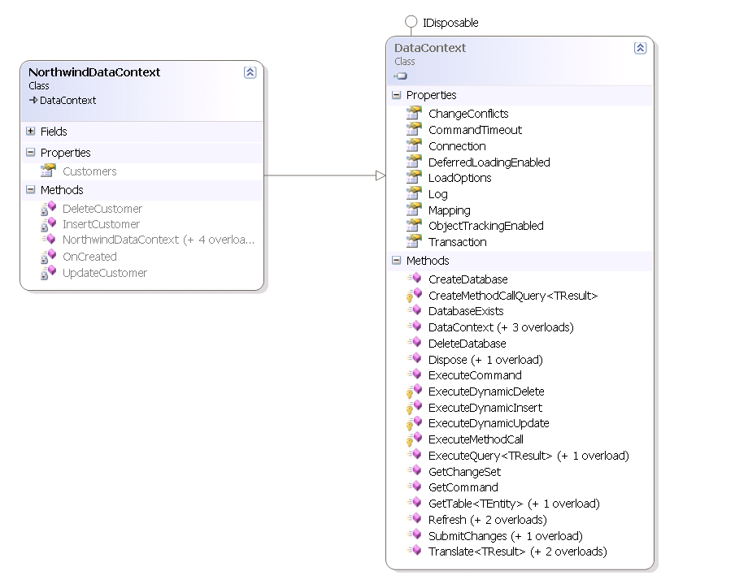
LINQ to SQL – The DataContext

Slide 19
Entity Framework
Entity Framework provides a rich layer of object data services
Object Services
LINQ to Entities and Entity SQL
Change tracking and identity management
Serialization and data binding
Connection and transaction management

Slide 20
Entity Framework Conceptual Model
Program against a conceptual entity data model
Entity model abstracted from storage model (database schema) by a mapping layer
Supports m:n mapping
Supports several inheritance schemes
LINQ to Entities works against conceptual model
ObjectContext is the gateway to entities
Entity Data Model
Mapping
Storage Model

Slide 21
Summary
LINQ – new query capabilities for the .NET Platform
LINQ standard operators work against IEnumerable<T>
LINQ providers open a wide variety of disparate data sources
LINQ to XML introduces a new XML API for .NET
LINQ to SQL / LINQ to Entities provide object/relational mapping features

Slide 22
References
LINQ: .NET Language Integrated Query – Don Box, Anders Hejlsberg (http://msdn2.microsoft.com/en-us/library/bb308959.aspx)
.NET Language Integrated Query For XML Data – Michael Champion (http://msdn2.microsoft.com/en-us/library/bb308960.aspx)

